Slide 1
Monadic computations in c++14
Radu Postelnicu

Slide 2
Category theory
Branch of mathematics that study categories
Practical applications in programming language theory (ex: monads)

Slide 3




Category
A category is an algebraic structure who contains “objects” that are linked by “arrows” (morphisms) following two basic properties:
$\text{Associative} \text{composition} \text{of} \text{the}\text{ “}\text{arrows}\text{”}$
$\text{Existence} \text{of} \text{the} \text{identity}\text{ “}\text{arrow}\text{”}$
1$a$
1$b$
A
f
B
g º f
g
C
1$c$

Slide 4








Functor
A mapping between two categories such that:
C$Y$= F(C$X$)
C$X$
F(1$a$) = 1$F(A)$
F(1$b$) = 1$F(B)$
1$a$
1$b$
A
f
F
F(A)
F(f)
B
F(B)
g º f
g
F(g º f) = F(g) º F(f)
F(g)
C
F(C)
1$c$
F(1$c$) = 1$F(C)$

Slide 5


Natural transformation
Provides a way of transforming one functor into another:
F
C$X$
η
C$Y$
G

Slide 6




Monad
Monad is basically an endofunctor (a functor mapping a category to itself) together with two natural transformations
Monad is a monoid (M, μ) where η is the identity transformation and μ is the binary operation
C$X$
1$a$
1$b$
A
f
B
(m, η, μ)
g º f
g
C
1$c$

Slide 7
Monad
In functional programming a monad is a structure (design pattern) that defines how functions, actions, inputs, and outputs are used together to build a computer program
Monads can be visualized as a value with an associated context (“box”)
This means we need:
A way to put a value in a box:
A way to bind (chain) multiple boxes (bind ⬄ take the value from the box, apply f then put the result back in the box):
return a =
a
a
>>= f : a ->
b
=
b

Slide 8
Monad
Its this associated context in which we can abstract:
Propagation of failure status (Maybe monad)
Propagation of error (Either monad)
Logging mechanism (Writer monad)
Simulate global state/configuration (Reader monad)
Non-deterministic computations (List monad)
Simulate state mutations (State monad)
Continuation passing computations (Continuation monad)

Slide 9
Monad
First we need some little helpers:
namespace tuple{
auto pair = [] (auto _1) {
return [_1] (auto _2) {
return [_1,_2] (auto accessor){
return accessor(_1)(_2); }; }; };
auto first = [] (auto p) {
return p([] (auto _1){
return [_1] (auto){
return _1; }; }); };
auto second = [] (auto p) {
return p([] (auto){
return [] (auto _2){
return _2; }; }); };
}
template <typename left, typename op> struct Left {
const left& left_operand;
const op& operation;
Left(const left& left_operand, const op& operation)
: left_operand(left_operand), operation(operation) {}
};
template <typename left, typename op >
auto operator << (const left& left_operand, op& operation) {
return Left<left, op>(left_operand, operation);
}
template <typename left, typename op, typename right>
auto operator >> (Left<left, op> leftStruct, const right& right_operand) {
return leftStruct.operation(leftStruct.left_operand, right_operand);
}

Slide 10
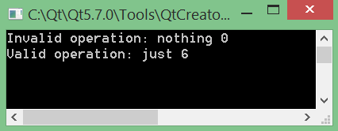
Maybe
Using tuples we can simulate the Maybe type:
Just a ⬄ (“just”, a)
Nothing ⬄ (“nothing”, 0)
#define then_maybe <<maybe::bind>>
namespace maybe{ auto mreturn = [] (auto val){ return tuple::pair("just")(val); };
auto bind = [] (auto ma, auto f) {
return tuple::first(ma) == "just“
? f(tuple::second(ma))
: tuple::pair("nothing")(0); };
}
namespace failingComputations{ //propagates failure status auto failingOp = [] (auto){
return tuple::pair("nothing")(0); };
auto increment = [] (auto x){
return tuple::pair("just")(x+1); };
auto testFailingComputations = [] () {
auto invalid = maybe::mreturn(4)
then_maybe failingOp
then_maybe increment; auto valid = maybe::mreturn(4)
then_maybe increment
then_maybe increment; std::cout<<"Invalid operation: “<<tuple::first(invalid)
<<" "<<tuple::second(invalid)<<std::endl;
std::cout <<"Valid operation: "<<tuple::first(valid)
<<" "<<tuple::second(valid)<<std::endl; };
}

Slide 11
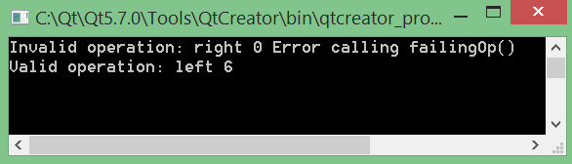
Either
}
Either type can be simulated as follows:
Left a ⬄ (“left”, (a,””))
Right err ⬄ (“right”, (0, err))
namespace errorComputations{ //propagates error auto failingOp = [] (auto){
return tuple::pair("right")(tuple::pair(0)("Error calling failingOp()")); };
auto increment = [] (auto x){
return tuple::pair("left")(tuple::pair(x+1)("")); };
auto testErrorComputations = [] () {
auto invalid = either::mreturn(4)
then_either failingOp
then_either increment; auto valid = either::mreturn(4)
then_either increment
then_either increment; std::cout<<"Invalid operation: "<<tuple::first(invalid)<<" “
<<tuple::first(tuple::second(invalid))
<<" "<<tuple::second(tuple::second(invalid))<<std::endl;
std::cout<<"Valid operation: "<<tuple::first(valid)<<" “
<<tuple::first(tuple::second(valid))
<<" "<<tuple::second(tuple::second(valid))<<std::endl; };
}
#define then_either <<either::bind>>
namespace either{
auto mreturn = [] (auto val){ return tuple::pair("left")(tuple::pair(val)("")); };
auto bind = [] (auto ea, auto f){
return tuple::first(ea) == "left“
? f(tuple::first(tuple::second(ea)))
: tuple::pair("right")(tuple::pair(tuple::first(tuple::second(ea)))(tuple::second(tuple::second(ea))));};
}

Slide 12
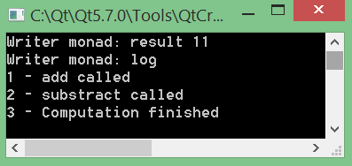
Writer
Logging mechanism can be simulated:
Writer ⬄ (a, log)
#define then_writer <<writer::bind>>
namespace writer{ auto mreturn = [] (auto val){ return tuple::pair(val)(std::string("")); };
auto bind = [] (auto wa, auto f){
auto newWriter = f(tuple::first(wa));
return tuple::pair(tuple::first(newWriter))(tuple::second(wa)
+ std::string("\n")
+ tuple::second(newWriter)); };
}
namespace writerMonad{
auto add = [] (auto x){
return [x] (auto y) {
return tuple::pair(x+y)("1 - add called"); }; };
auto substract = [] (auto x){
return [x] (auto y) { return tuple::pair(y-x)("2 - substract called"); }; };
auto finishComputation = [] (auto x){
return tuple::pair(x)("3 - Computation finished"); };
auto testLoggingComputations = [] () {
auto logComp = writer::mreturn(10)
then_writer add(3)
then_writer substract(2)
then_writer finishComputation;
std::cout<<"Writer monad: result "<<tuple::first(logComp)<<std::endl;
std::cout<<"Writer monad: log "<<tuple::second(logComp)<<std::endl; };
}

Slide 13
Reader
We can simulate a Reader monad as a function:
Reader⬄ f : env -> a
namespace readerMonad{
//example 1 auto greet = reader::ask
then_reader [] (auto who) {return reader::mreturn("Hello, " + who);};
//example 2 typedef enum{
CFG_0 = 0,
CFG_1,
CFG_2
}ConfigTable;
auto logWhichCfg = reader::ask
then_reader [] (auto cfg) {
std::cout<<"Used config: "<<(int)cfg<<std::endl;
return reader::mreturn(cfg);}; auto doSomethingForCFG_1 =
reader::asks([] (auto cfg) {return cfg == CFG_1;})
then_reader [] (auto isCFG_1) {
return isCFG_1
? reader::mreturn("Setup ok!")
: reader::mreturn("Error: CFG_1 not used!!!");};
auto computation =
logWhichCfg
then_reader [] (auto) {return doSomethingForCFG_1;};
#define then_reader <<reader::bind>>
namespace reader{ auto runReader = [] (auto ra, auto init_env) {
return ra(init_env); };
auto mreturn = [] (auto val) {
return [val] (auto /*env*/) {
return val; }; };
auto bind = [] (auto ra, auto f){
return [ra, f] (auto env) {
return runReader(f(runReader(ra, env)), env); }; };
auto ask = [] (auto env) {return env;};
auto asks = [] (auto f){
return ask
<<bind>> [f] (auto env) {
return mreturn(f(env));}; }; }

Slide 14
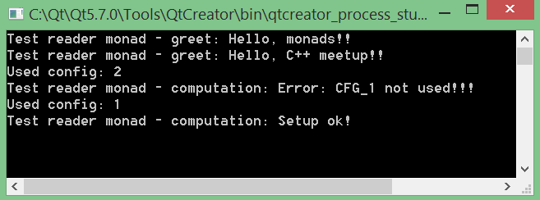
Reader
Testing the Reader monad
auto testReaderMonad = [] () {
auto helloMonads = reader::runReader(greet, std::string("monads!!"));
auto helloMeetup = reader::runReader(greet, std::string("C++ meetup!!"));
std::cout<<"Test reader monad - greet: "<<(std::string)helloMonads<<std::endl;
std::cout<<"Test reader monad - greet: "<<(std::string)helloMeetup<<std::endl;
auto errorComp = reader::runReader(computation, CFG_2);
std::cout<<"Test reader monad - computation: "<<(std::string)errorComp<<std::endl;
auto successComp = reader::runReader(computation, CFG_1);
std::cout<<"Test reader monad - computation: "<<(std::string)successComp<<std::endl; };
}

Slide 15
List
Lists can be simulated with tuples too:
List a ⬄ (a, (a, (a, (…, (nullptr)))))
template<class none = void> auto make_list() {
return nullptr;
}
template<class Type, Type First, Type... Rest> auto make_list() {
return tuple::pair(First)(make_list<Type, Rest...>());
}
auto head = tuple::first;
auto tail = tuple::second;
auto cons = [] (auto x, auto xs) { return tuple::pair(x)(xs); };

Slide 16
List
What else can we define for a list?
template<class List, class F> auto map(List lst, F f){
auto result = f(head(lst));
return tuple::pair(result)(map(tail(lst), f));
}
template<class F> auto map(std::nullptr_t, F){
return nullptr;
}
template<class List, class F, class Init> auto foldLeft(List lst, F f, Init init){
return foldLeft(tail(lst), f, f(init, head(lst)));
}
template <class F, class Init> auto foldLeft(std::nullptr_t, F, Init init){
return init;
}
template<class List, class F, class Init> auto foldRight(List lst, F f, Init init){
return f(head(lst), foldRight(tail(lst), f, init));
}
template <class F, class Init> auto foldRight(std::nullptr_t, F, Init init){
return init;
}
auto append = [] (auto lst_a, auto lst_b){
return foldRight(lst_a, [] (auto elem, auto acc) {
return elem <<cons>> acc; },
lst_b); }; auto concat = [] (auto lst){
return foldLeft(lst, append , nullptr);
};

Slide 17
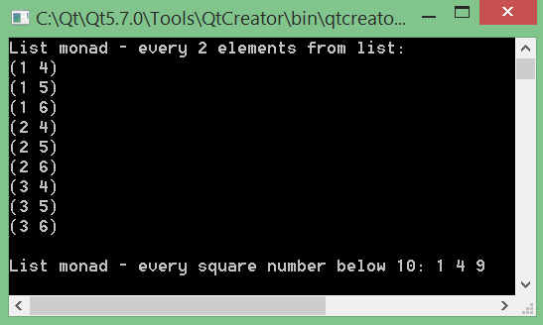
List
Now we have everything we need to define the List monad
#define then_list <<list::bind>>
auto show = [] (auto lst){
auto _show = [] (auto lst) {
map(lst, [] (auto elem) {std::cout<<elem<<" "; return "";});
};
_show(lst); std::cout<<"nil"<<std::endl;
};
auto mreturn = [] (auto x) {
return tuple::pair(x)(nullptr); };
auto bind = [] (auto sa, auto f){
return concat(map(sa, f)); };
namespace listMonad{ auto every2Elements = [] (auto lst_a, auto lst_b){
return lst_a
then_list [lst_b] (auto x) {return lst_b
then_list [x] (auto y) {return list::mreturn(tuple::pair(x)(y));};}; };
auto everySquare = [] (auto lst) {
return lst
then_list [lst] (auto x) {return lst
then_list [x] (auto y) {return y*y == x ? list::mreturn(x) : list::mreturn(0);};}; };
auto testListMonad = [] () { std::cout<<"List monad - every 2 elements from list \n";
auto res = every2Elements(list::make_list<int, 1,2,3>(), list::make_list<int, 4,5,6>());
list::map(res, [] (auto elem) {
std::cout<<"("<<tuple::first(elem)<<" "<<tuple::second(elem)<<")"<<“\n";
return ""; });
std::cout<<std::endl;
std::cout<<"List monad - every square number below 10: ";
auto list10 = list::make_list<int, 1,2,3,4,5,6,7,8,9,10>();
auto everysq = everySquare(list10);
list::map(everysq, [] (auto e) {
e == 0 ? std::cout<<"" : std::cout<<e<<" "; return e;});
std::cout<<std::endl; };
}

Slide 18
State
State monad can be simulated as follows:
State ⬄ f : s -> (a, s)
#define then_state <<state::bind>>
namespace state{
auto runState = [] (auto sa, auto init_state){
return sa(init_state); };
auto mreturn = [] (auto val){
return [val] (auto state){
return tuple::pair(val)(state); }; };
auto bind = [] (auto sa, auto f){
return [sa, f] (auto state){
auto temp = runState(sa, state);
auto new_state = f(tuple::first(temp));
return runState(new_state, tuple::second(temp)); }; };
auto get = [] (auto state){ return tuple::pair(state)(state); };
auto put = [] (auto x) {
return [x] (auto){
return tuple::pair(nullptr)(x); }; };
auto evalState = [] (auto sa, auto f){
return tuple::first(runState(sa, f)); }; auto execState = [] (auto sa, auto f){
return tuple::second(runState(sa, f)); };
}

Slide 19
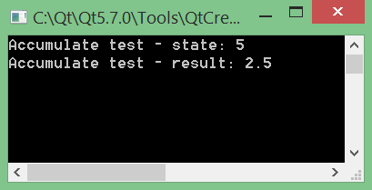
State
Let’s test the state monad:
namespace Accumulate{ auto add = [] (auto x) {
return state::get
then_state [x] (auto sum) {return state::put(sum+x);}; };
auto substract = [] (auto x){
return state::get
then_state [x] (auto sum) {return state::put(sum-x);}; };
auto half =
state::get
then_state [] (auto sum) {return state::mreturn(sum/2.0);};
auto accOperations =
add(3)
then_state [] (auto) {return add(4)
then_state [] (auto) {return substract(2)
then_state [] (auto) {return half;};};};
auto testAccumulate = [] () {
auto result = state::evalState(accOperations, 0);
auto state = state::execState(accOperations, 0);
std::cout<<"Accumulate test - state: "<<state<<std::endl;
std::cout<<"Accumulate test - result: "<<result<<std::endl; };
}

Slide 20
State
Let’s see if we can model a stack
namespace Stack{ auto pop = state::get
then_state [] (auto state) {auto pop_result = list::head(state); return state::put(list::tail(state))
then_state [pop_result] (auto) {return state::mreturn(pop_result);};};
auto push = [] (auto x) {
return state::get then_state [x] (auto state) {return state::put(x <<list::cons>> state);}; };
auto top = state::get
then_state [] (auto state) {auto top_result = list::head(state); return state::put(state)
then_state [top_result] (auto) {return state::mreturn(top_result);};};
auto stackManip = push(1)
then_state [] (auto) {return push(2)
then_state [] (auto) {return push(3)
then_state [] (auto) {return push(4)
then_state [] (auto) {return push(5)
then_state [] (auto) {return pop
then_state [] (auto) {return pop then_state [] (auto) {return top;};};};};};};};
auto addFirst2 = pop
then_state [] (auto x) {return pop
then_state [x] (auto y) {auto sum = x+y; return push(sum)
then_state [sum] (auto) {return state::mreturn(sum);};};};
auto manipAndThenAddFirst2 = stackManip then_state [] (auto) {return addFirst2;};

Slide 21
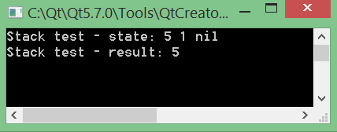
State
Test the stack api
auto testStack = [] () {
auto lst = list::make_list<int>();
auto result = state::evalState(manipAndThenAddFirst2, lst);
auto state = state::execState(manipAndThenAddFirst2, lst);
//result is (<result>, <state>)
std::cout<<"Stack test - state: "; list::show(state);
std::cout<<"Stack test - result: "<<result<<std::endl; };

Slide 22
Continuation
A continuation can be modeled as:
Cont⬄ f : (g : a -> r) -> r
namespace continuationMonad{ auto testContinuation = [] () {
auto runCont = [] (auto ca, auto cont){
return ca(cont); };
auto mreturn = [] (auto val){
return [val] (auto cont) { return cont(val); }; };
auto bind = [runCont] (auto ca, auto f) {
return [ca, f,runCont] (auto cont) {
return ca([f, cont,runCont] (auto x) {
return runCont(f(x), cont);}); }; };

Slide 23
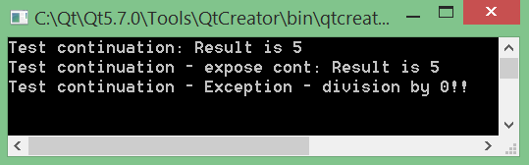
Continuation
Test the Continuation monad:
auto computation = mreturn(10)
<<bind>> [=] (auto a) {return mreturn(2)
<<bind>> [=] (auto b) {return mreturn(a/b);};};
runCont(computation, [] (auto res) {std::cout<<"Test continuation: Result is "<<res<<std::endl;});
auto compExposeContinuation = mreturn(10)
<<bind>> [=] (auto a) {return mreturn(2)
<<bind>> [=] (auto b) {return [=] (auto cont) { /*do extra work*/ return cont(a/b);};};};
runCont(compExposeContinuation, [] (auto res) {std::cout<<"Test continuation - expose cont: Result is "<<res<<std::endl;});
auto compIgnoreContinuation = [=] (auto exHandler) {
return mreturn(10)
<<bind>> [=] (auto a) {return mreturn(0)
<<bind>> [=] (auto b) {return [=] (auto cont) {return b == 0 ? exHandler() : cont(a/b);};};};};
runCont(compIgnoreContinuation([] () {std::cout<<"Test continuation - Exception - division by 0!!"<<std::endl;}),
[] (auto res) {std::cout<<"Test continuation - compIgnoreContinuation: Result is "<<res<<std::endl;}); };
}

Slide 24
Other monads
IO monad
Threading monad
Macro monad
Parser monad
Every generic data type that implements return and >>=
All in the name of referential transparency
E(a, s₁) == E(a, s₂) where s₁ , s₂ are the states of the system

Slide 25
Q&A

Slide 26
Thank you for your attention!

